Slide 1
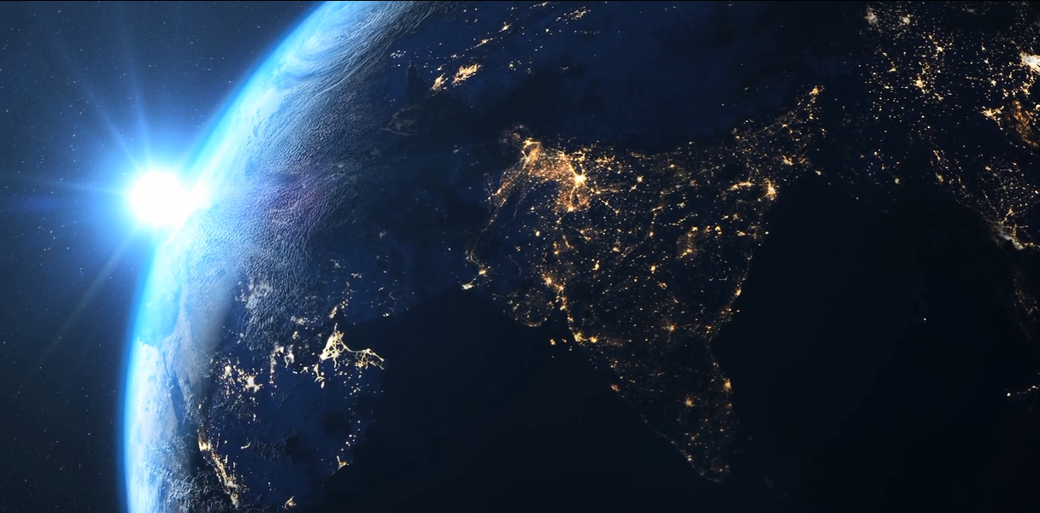
Make the World… more sustainable
Notes:
Image: Public Domain: Pixabay

Slide 2

Sustainable energy solutions
What is sustainability?
The World Commission on Environment and Development describes sustainable development as:
“…development that meets the needs of the present without compromising the ability of future generations to meet their own needs”.
We need to stop exploiting the earth’s resources and consider alternative designs and production methods when coming up with new product ideas.
Sustainable design is fast becoming a matter of global corporate citizenship. More consumers are choosing products based on their environmental impact, forcing manufacturers to reconsider how they develop and market products.
Notes:
Image: Public Domain: Pixabay

Slide 3
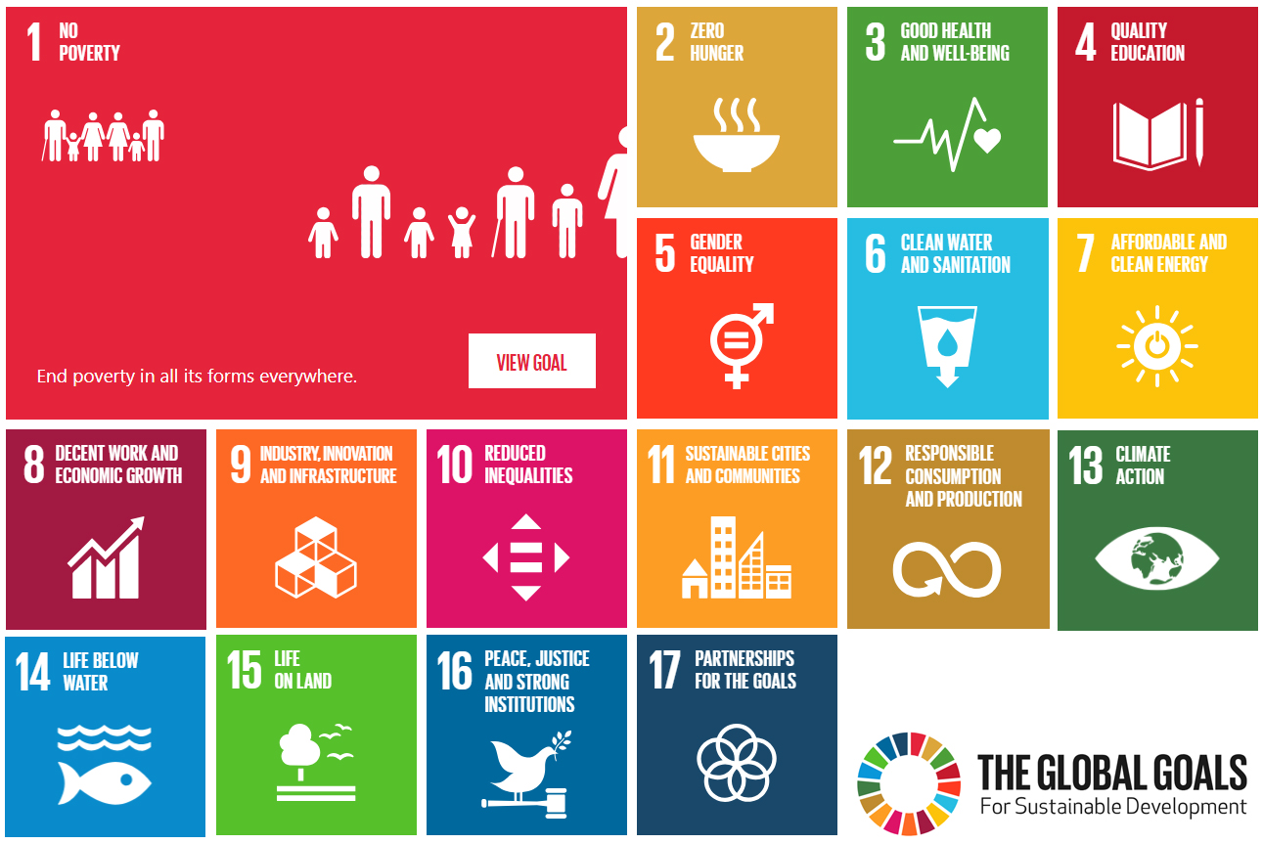
Sustainable energy solutions
Global Goals
The Sustainable Development Goals or Global Goals were developed by the United Nations in 2015 with the aim of ending world poverty by 2030.
Certain goals apply to product designers, including developing affordable and clean energy, clean water and sanitation and encouraging responsible consumption and production.
Designers should take account of the issues highlighted through the goals when designing and making new products.
Notes:
Image: Practical Action

Slide 4
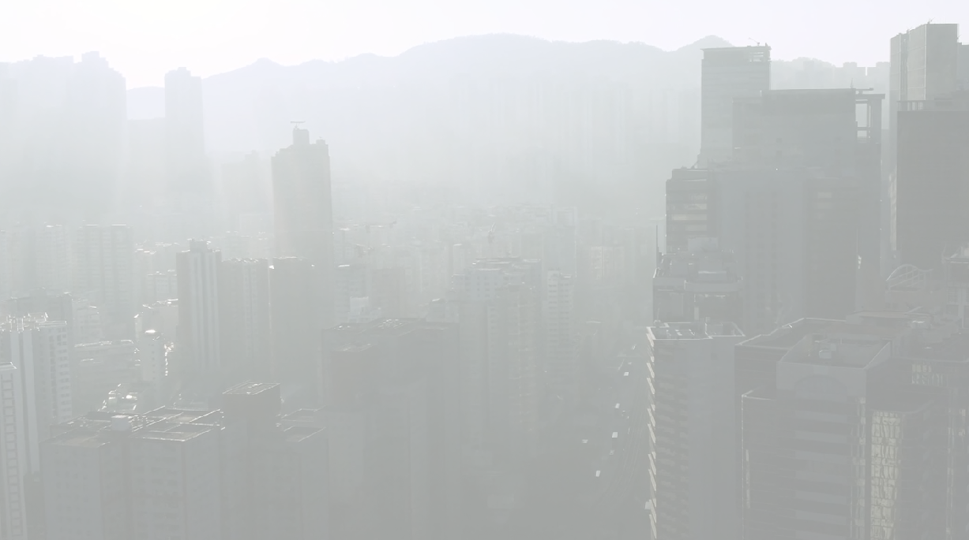

Sustainable energy solutions
Designing with sustainability in mind
Watch Video1 to see the impact that our need for new products has an impact on the world’s resources and how we should consider alternative solutions.
Click the image to view the video.
Notes:
Background image: Public Domain: Pixabay

Slide 5
Sustainable energy solutions
Designing with sustainability in mind
Remember:
Living standards are improving
More people have access to products and facilities
But…
Products demand more energy to operate
There are more people...
On the same sized world...
With limited and dwindling resources…
And we’re encroaching on natural habitats
Notes:
Background image: Public Domain: Pixabay

Slide 6
Sustainable energy solutions
Designing with sustainability in mind
If we don’t find solutions we will run out of resources and this will limit people’s access to products, resulting in inequalities and non-environmentally friendly forms of power.
Ultimately, we will run out of space for us and the world’s other creatures.
Notes:
Background image: Public Domain: Pixabay

Slide 7
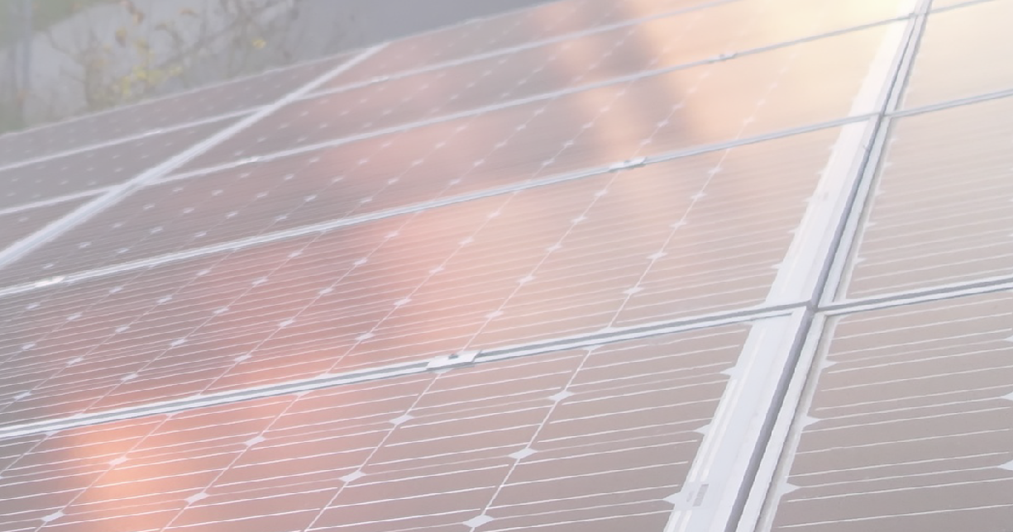
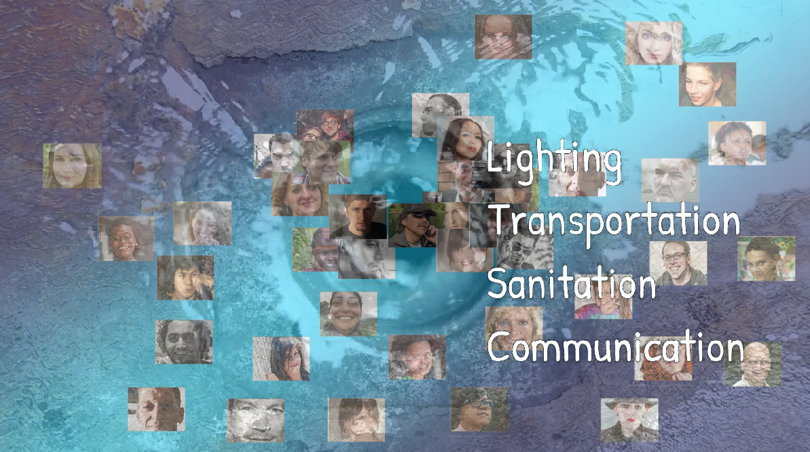
Sustainable energy solutions
Sustainable energy
Video 2 has information on how sustainable energy can offer alternative solutions to our growing need for energy.
Click the image to view the video.
Notes:
Background image: Public Domain: Pixabay

Slide 8
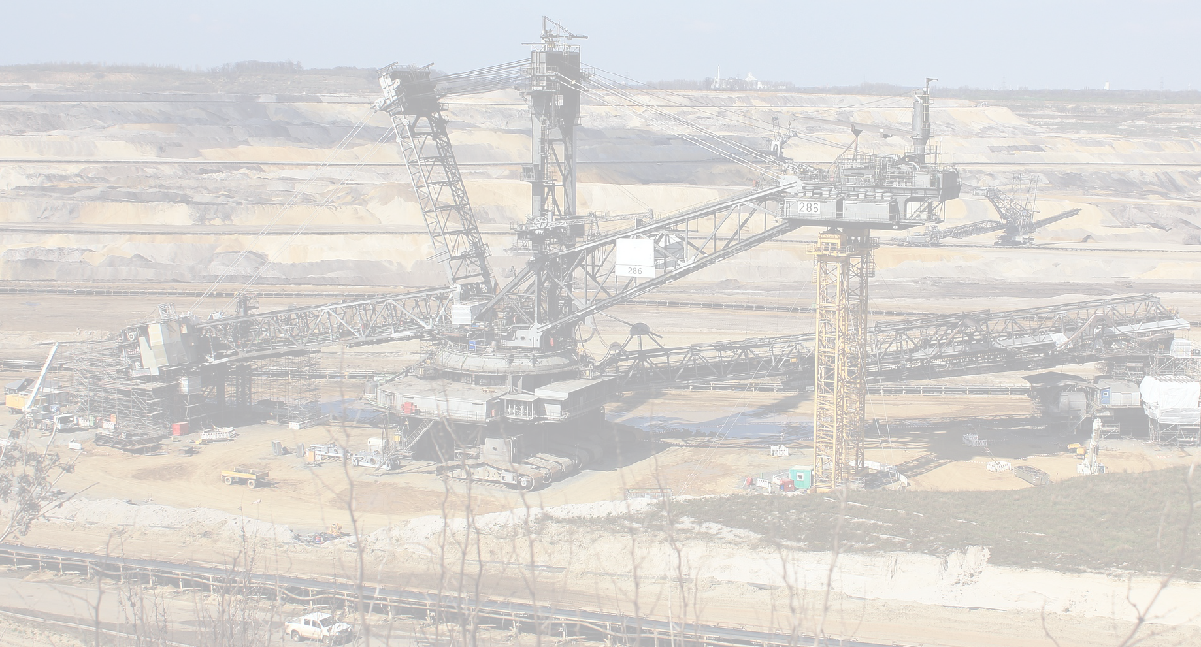
Sustainable energy solutions
Sustainable energy
How are we going to provide energy for all the things we produce?
Coal and Oil: limited supply and difficult and dangerous to extract and transport
Nuclear Power: expensive and with unknown, lasting effects
Water Turbines: better but needing an expensive infrastructure
Notes:
Background image: Public Domain: Pixabay

Slide 9
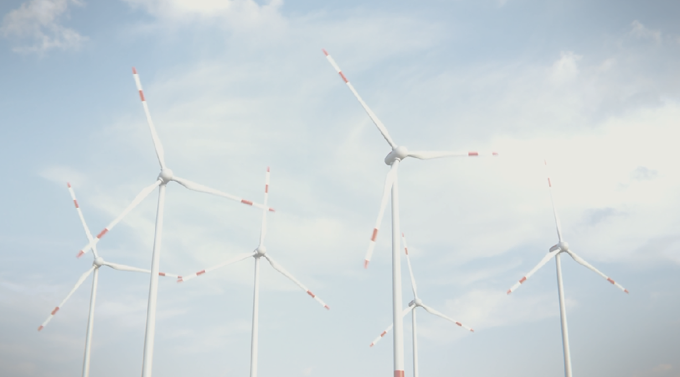
Sustainable energy solutions
Renewable energy
Solar, wind and wave power use the natural environment to provide what we need without depleting its resources.
Notes:
Background image: Public Domain: Pixabay

Slide 10
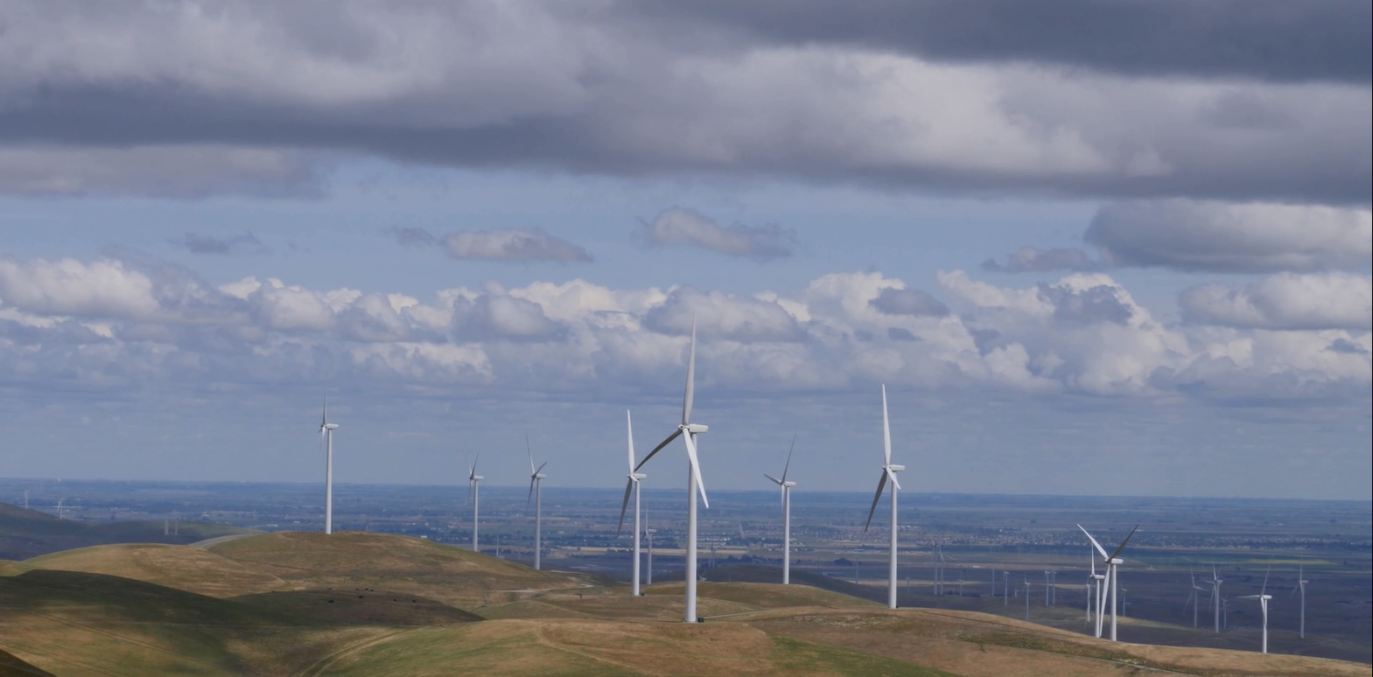
Sustainable energy solutions
Wind and solar power
Plan, design, make and test model solutions to the need for energy using alternative energy.
From your D&T lessons you should already have an understanding of circuits, structures and mechanisms which will help you to think about and focus on sustainable problem-solving solutions.

Slide 11
Sustainable energy solutions
Wind and solar power
Take a look at these:
Solar Challenge
Wind Power Challenge
Power for the World
Use the resources to help you make and test model wind turbines and solar solutions.

Slide 12
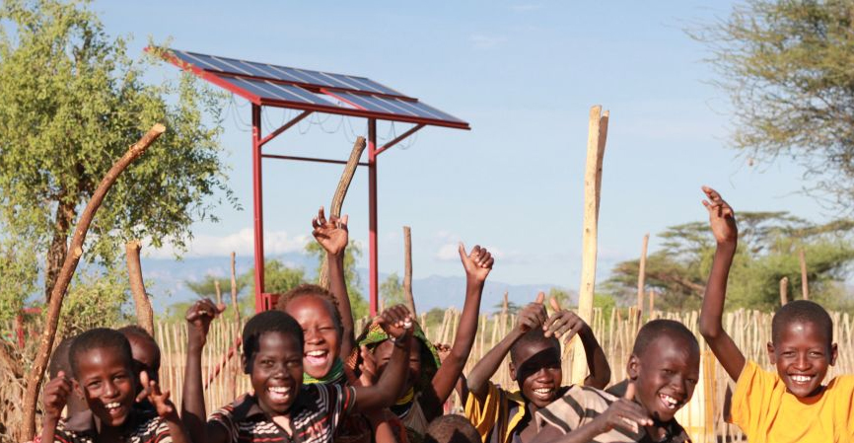
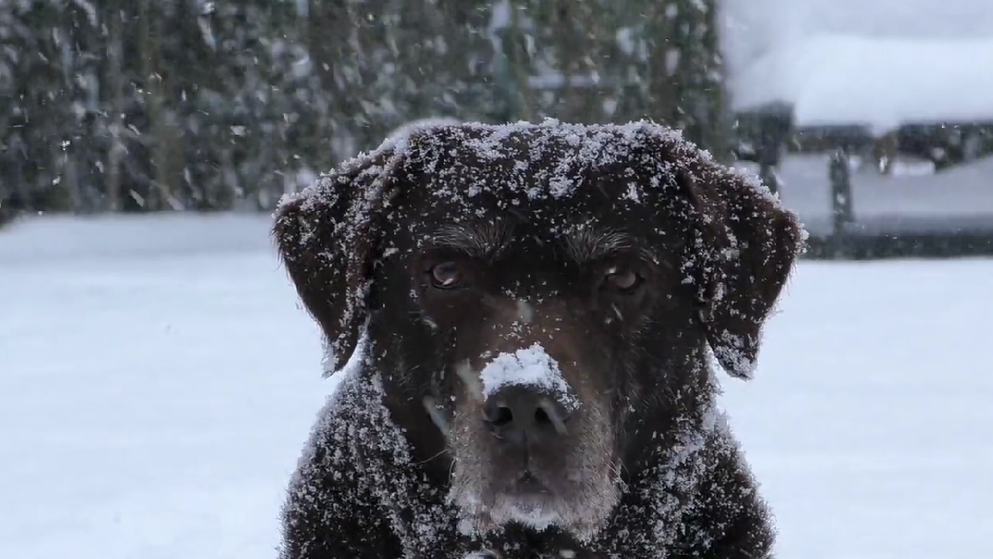
Sustainable energy solutions
Scenarios
Solving problems using sustainable energy
Watch Video 3: Scenarios
Click the image to view the video.
Notes:
Image: Practical Action

Slide 13
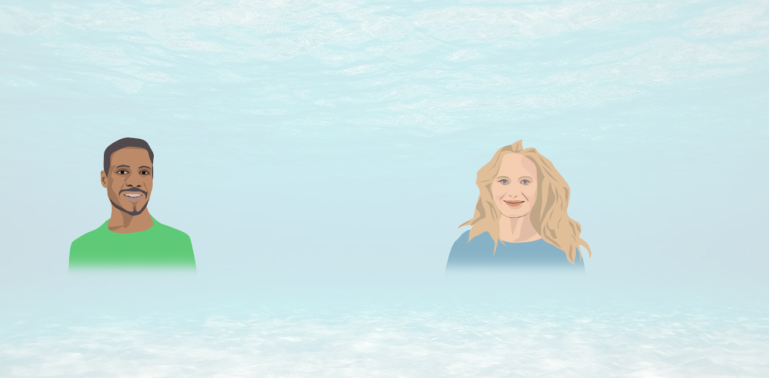
Sustainable energy solutions
Solving problems
Sunny lives in rural Kenya where there is no immediate access to electricity. Design a solution that means Sunny’s family can make more use of the light they need to help them at home and work.
Windy lives on an island next to the sea. How can her family heat their home to stay warm in winter?

Slide 14

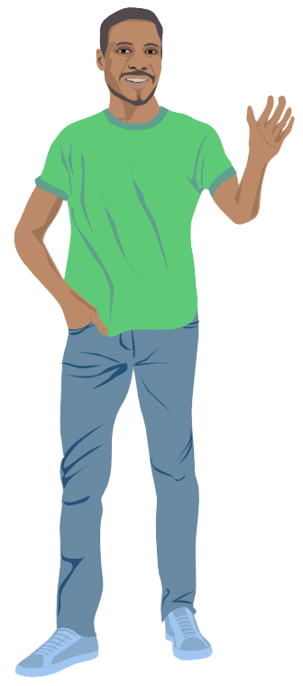
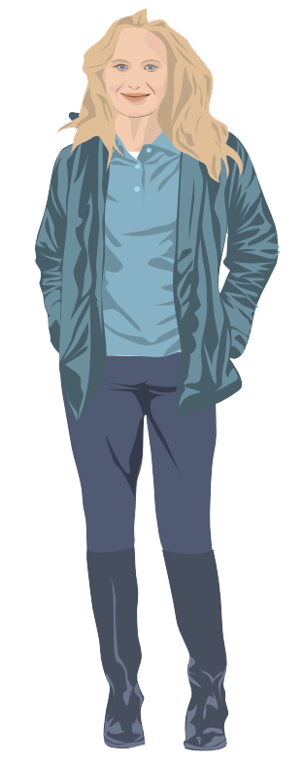
Sustainable energy solutions
Scenarios
Use what you have learned researching wind and solar energy to come up with solutions to the problems Sunny and Windy have.
You might need to think about:
The locations and what natural resources are available
Harnessing the power of the sun and wind efficiently
Long term use and maintenance
Make models based on your research and test the efficiency of each by adjusting the parameters of the inputs and outputs.

Slide 15
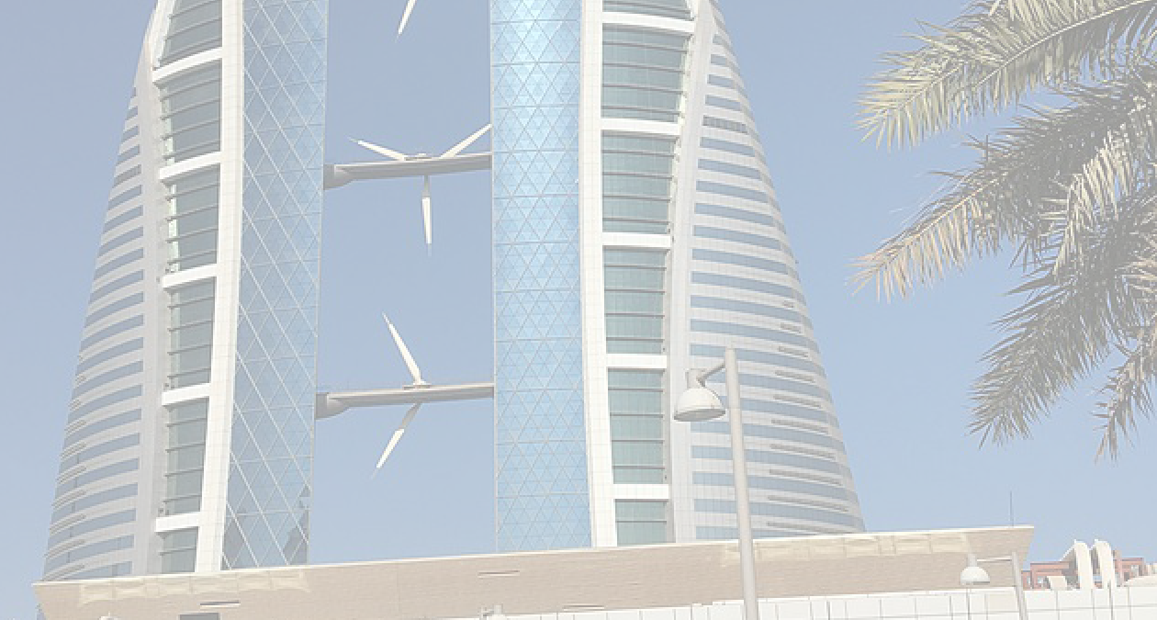

Sustainable energy solutions
Engineering for change
Video 4: Engineering for change
Click the image to view the video.
Notes:
Background image: Public Domain: Wikipedia

Slide 16

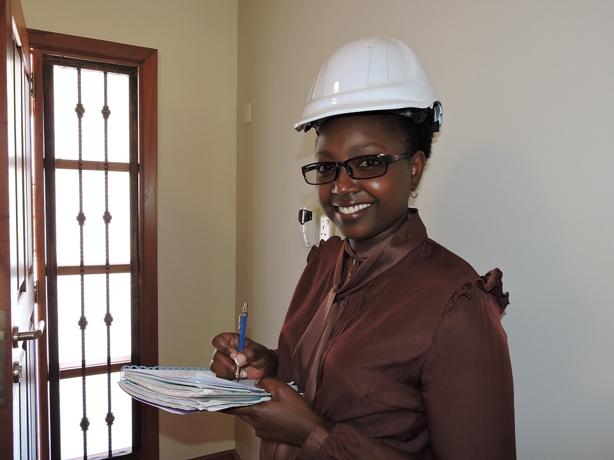
Sustainable energy solutions
What does an engineer do?
Sustainability must be considered in all new design and engineering projects and engineers, in whatever discipline, now have this at the forefront of their thinking.
Engineers work in many areas, including the design, electronics, automotive, aeronautics, maintenance, construction, manufacture and biomedical industries.
Notes:
Image: Public Domain: Pixabay

Slide 17
Sustainable energy solutions
Find out more
The ERA Foundation has support for emerging engineers in all sectors.
Engineers Without Borders has examples of their work with sustainable design around the world.
Born to Engineer offers careers advice and resources to help you decide your future.
Practical Action has resources that support sustainable solutions across the globe.
Smallpeice Trust and Arkwright have courses, case studies and scholarships
Engineering UK gives support across the industry including through Tomorrow’s Engineers
Notes:
Image: Public Domain: Pixabay

