Slide 1



Reimagining Design and Technology education
Name: Tony Ryan
Position: Chief Executive Officer
www.designtechnology.org.uk
Notes:
Introduction. Thank you for the invitation to speak. Delighted to be here and honoured to be asked to speak

Slide 2
The Design and Technology Association was founded in 1989.
Its core function is to support, promote and develop high quality D&T learning as part of a broad and creative curriculum up to the age of 18.
We are a registered charity, seventeen people in size and with a yearly turnover of just over £1 Million.
Because design and innovation matter
Notes:
Last 5 years at the association. 33,000 members, connection with industry, lobbying

Slide 3

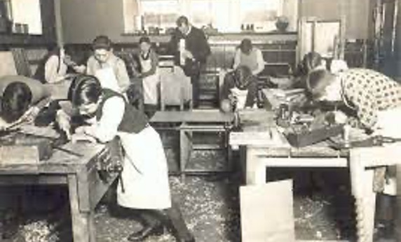
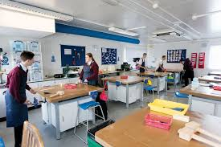
We initially filled the role of providing craft and home skills. Woodwork, metalwork, technical drawing, cooking and handicraft.
CDT emerged in the 80s and introduced a greater emphasis on design. Textiles and food technology developed alongside and integral to this offer but with separate Level 2/3 Quals.
Design and technology emerged with the new National Curriculum in 1988. A combined KS1/2 and 3 but separating into specialisms at KS4 and KS5.
The ‘new’ specifications for D&T came into effect in 2015. Textiles was incorporated into this offer, and Food Technology became Food and Nutrition at GCSE only (No level 3 spec).
THE SUBJECT’S JOURNEY
Because design and innovation matter
Notes:
A journey from craft to design focus. We once led the world but in recent years have lost our way. We need to once again be world leading

Slide 4


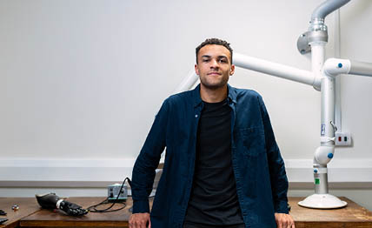

Design and technology in schools is in a state of national neglect.
In 2003 we had 430,000 GCSE entries and over 20,000 at A Level.
Now 78,000 and just over 10,000.
In 2009 we had 14,800 trained and qualified teachers, this number is now estimated at 6,500.
The subject has lacked leadership and direction.
Meanwhile, design alone contributed £97 Billion to GDP last year. This figure rises to over £600 Billion when engineering and manufacturing are added to this total. Together these sectors employ 1:8 of the UK workforce.
Because design and innovation matter
Notes:
The key message here is our subject is more relevant now than it has ever been (add data sources) Design Economy 2022 and IET report

Slide 5

If we do nothing, we estimate that we are a matter of three to four years away from curriculum obscurity. We will lose more teachers and students and the subject will drift to the very margins of the curriculum.
For these reasons, I would suggest we need to urgently discuss what reform is required to allow the subject to meet the future needs of our students and then act to make this change happen.
Because design and innovation matter
Notes:
14,800 trained specialists in 2009, less than 6,500 now

Slide 6

ACTIONS TAKEN SO FAR

Slide 7

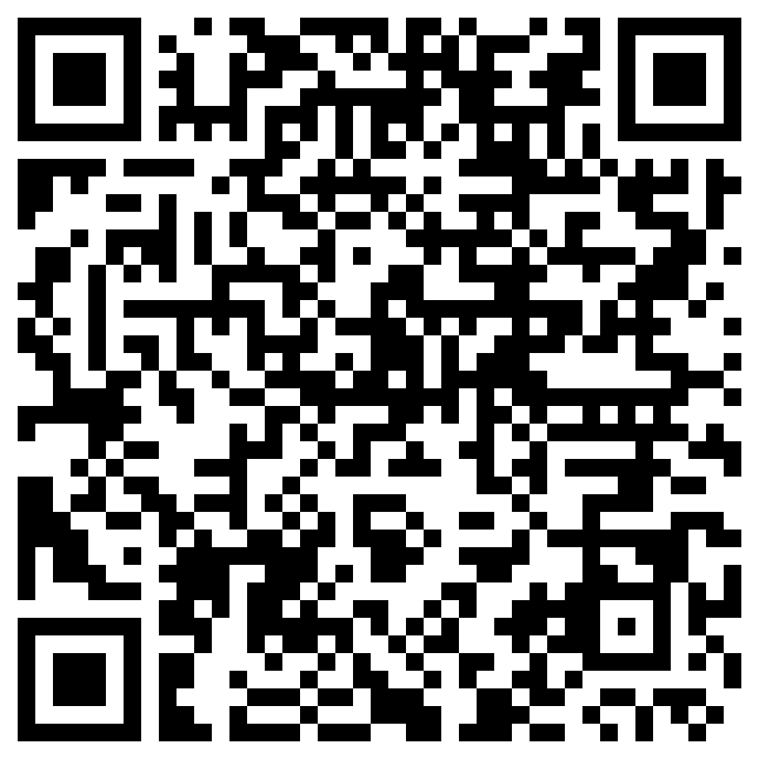
Actions taken to date (1)
In 2021 working with key partner’s to help fund the work, we commissioned the Education Policy Institute to conduct some research into the current standing of D&T in England. This report was published in March 2022
https://www.data.org.uk/news/new-report-dt-in-schools-fallen-over-last-decade-and-will-continue-without-government-intervention
Partners for EPI Paper joining the Association were Foster & Partners Architects, The IET, ERA Foundation, The James Dyson Foundation
Because design and innovation matter
Notes:
Lots of bad news, secondary data but all in one place - The only way is up from here. Important to look forward, not seek scapegoats

Slide 8


Actions taken to date (2)
Following the EPI reports publication in late March 2022, we set up a series of roundtable discussions involving subject leaders, headteachers, Trust Executive Heads, business and sector leaders, keeping the Government informed throughout.
These meetings were held in person and online and culminated in a half-day workshop held at the Royal Academy of Engineering.
Because design and innovation matter
Notes:
School and sector leaders. Industry partners and headteachers/Trust executive heads

Slide 9


ACTIONS TAKEN TO DATE (3)
The recommendations from these roundtable meetings were then taken on the road to meet teachers in nine cities over a period of three weeks. This meeting cycle culminated in an online meeting that had over sixty teachers in attendance.
Over three hundred teachers were consulted in total.
Brighton, London, Birmingham, Manchester, Liverpool, Norwich, Newcastle, Bristol, Cardiff. Ending with an online session with over 60 attending
Because design and innovation matter
Notes:
Brighton, London, Birmingham, Manchester, Liverpool, Norwich, Newcastle, Bristol, Cardiff. Ending with an online session with over 60 attending

Slide 10

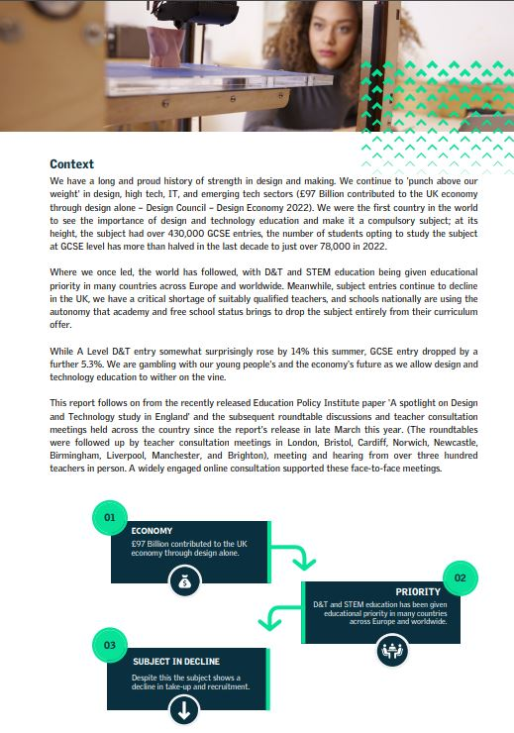
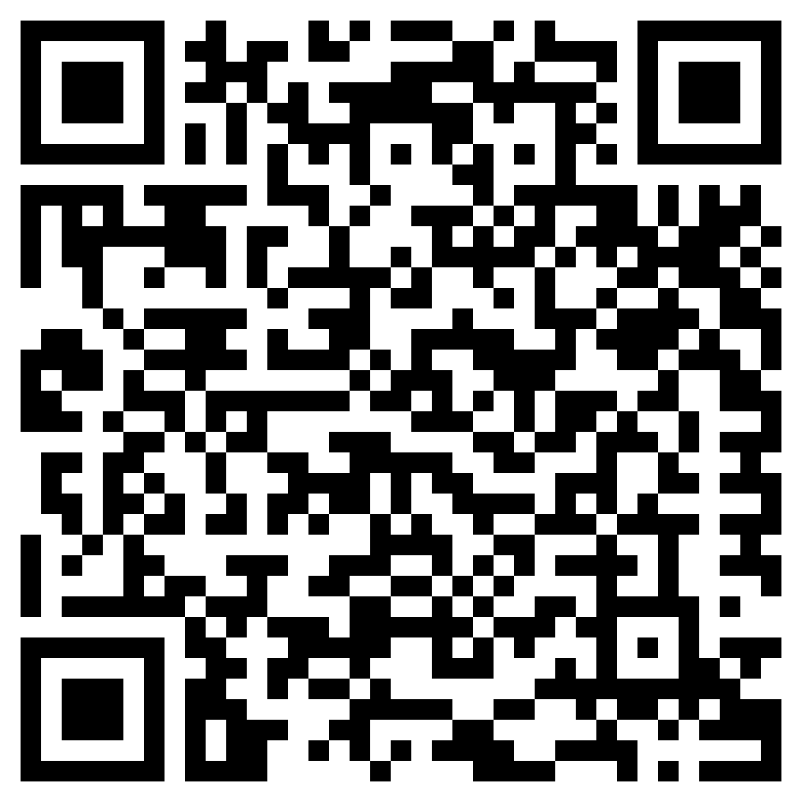
ACTIONS TAKEN TO DATE (4)
From these meetings, the Reimagining D&T paper was drawn up. This was then presented at both the Labour and Conservative Party Conferences where it was well-received.
We are now fully focused on delivering this paper.
Because design and innovation matter

Slide 11




MAIN ACTION POINTS FROM THE REIMAGINING D&T REPORT
  Development
  Curriculum innovation, development and consistency in delivery and assessment. Initially concentrating on KS3.
Subject research
We are still a young subject and lack the research base of more-established curriculum subjects. Increase the amount and quality of subject-based research and ensure that this work reaches teachers and informs practice.
Demonstrate and show
Showcase what good and outstanding looks like in the subject. More than a website as we seek to engage new audiences.
Connect
Connect the often disparate worlds of business and education in order to close the skills gap, increase diversity and showcase exciting career paths.
Because design and innovation matter
Notes:
Four areas of action – None require government intervention

Slide 12




CALLS FOR ACTION FROM GOVERNMENT
Further increase the ITT bursary from its current £20k figure to match maths, physics, chemistry and computer science on £27k.
The Government to set up incentives for industry professionals to move into teaching design and technology. Modelled on the Engineers Teach Physics pilot.
The Government to urgently consider allowing businesses paying the Apprenticeship Levy to donate unspent levy to local schools to be used for teacher professional development.
Notes:
Point three we accept is unlikely under a Conservative Government (Robert Halfon). Points one and two are easy with appropriate Govt. backing.

Slide 13

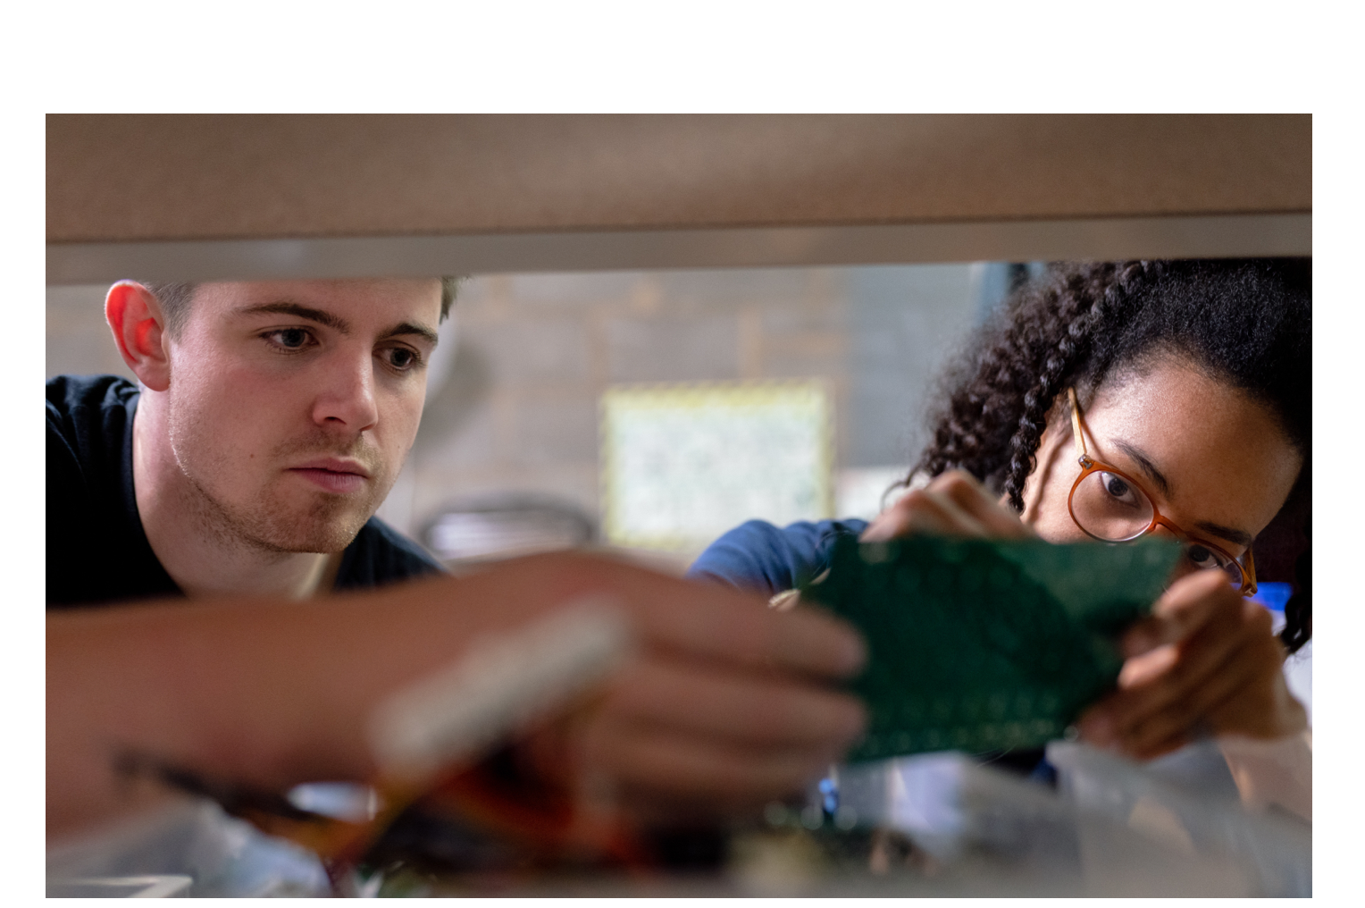
Challenges posed in delivering the reimagining paper
The KS3 Contextual work requires a budget of £165K to deliver. We will need to raise this through sponsorship by the end of March at the latest.
20 Contextual Projects with supporting materials is a challenge in six-months.
All the above must be free to teachers (not just members) if we are to get wide take-up.
The DfE is not completely sold on ‘building from the bottom’, not feeling it will provide the ‘transformational change’ required.
Research and showcasing will require separate budget lines.
The subject has experienced false dawns before, what’s different this time?
The only response we have is this time we deliver!
Because design and innovation matter
Notes:
DfE comments so far…They want “transformational change” (Civil servants). Balance between playing the right political game and doing what we believe to be right

Slide 14
So where to from here?
Notes:
Vision starts here

Slide 15

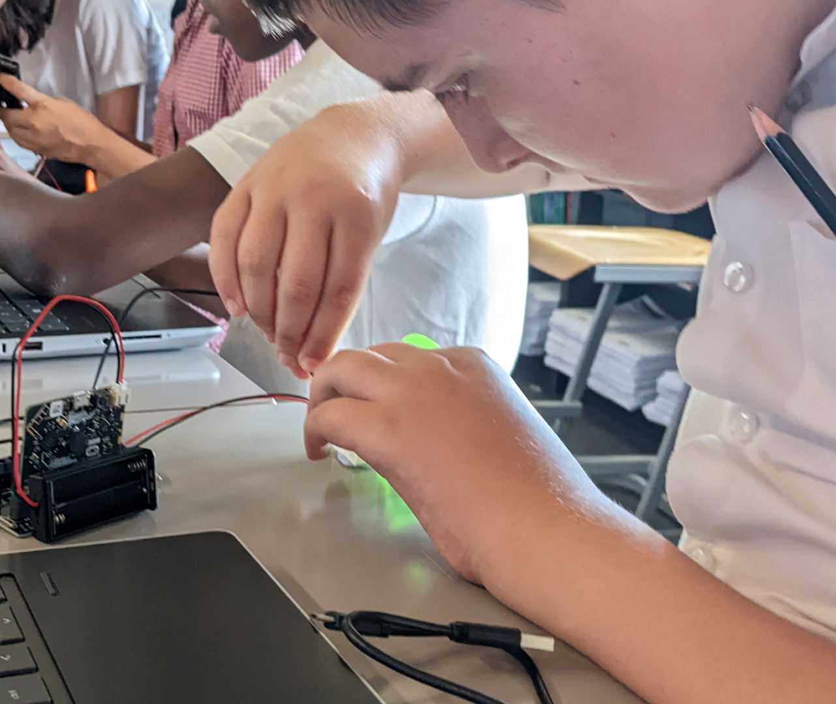

PRIMARY EDUCATION – Current situation
We have seen membership increase from 976 schools and 5,986 members in January 2019 to 2,246 schools and 29,187 members today. By the end of 2023, we expect to have one-third of all primary schools as members.
Ofsted driven and predominantly taught by teachers with no STEM background and minimal subject training (Avg. six hours ITT).
Where taught well (increasingly the case), pupils learn to design, make, and evaluate responses to set design tasks, learning to improve their ideas through iteration.
The PoS for KS1 and KS2 stretches teachers and pupils, but with sufficient support and guidance, is deliverable.
Notes:
Teachers don’t want and arguably cannot cope with “transformational change” important to build on what we have gained and not lose the audience

Slide 16

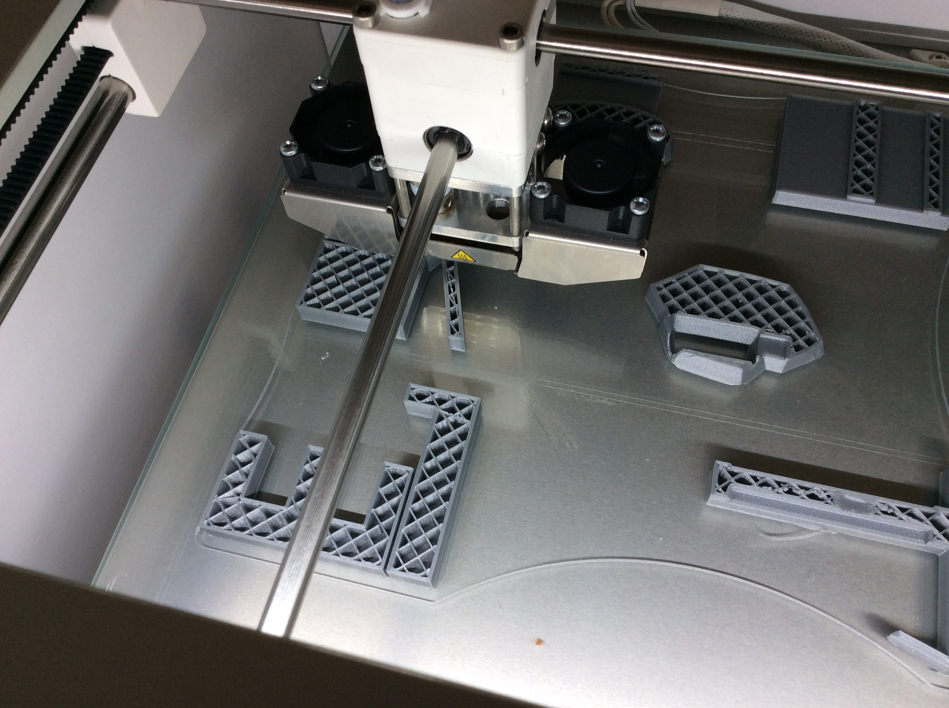
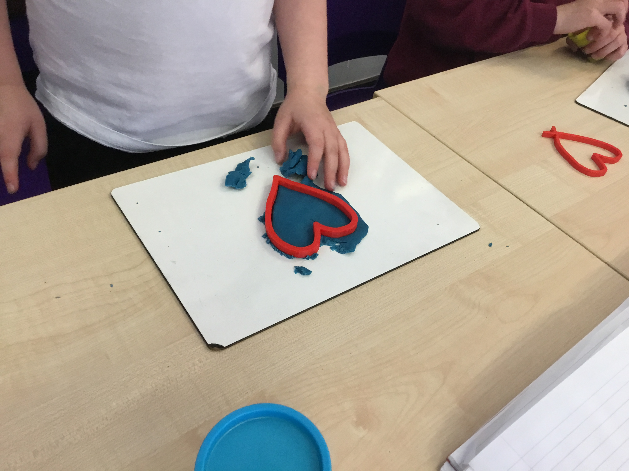
Primary – Proposed curriculum development
We believe pupils need to be able to explore the need for sustainability and for energy conservation to be at the very heart of effective design. Pupils need to place this knowledge in the context of their own lives.
We would like to see a greater emphasis on design thinking, empathetic design, iteration of design, teamwork and presentation of design ideas.
A very successful trial over the course of the last year with Blueprint partners Create Education has proven the value of introducing additive manufacturing to the primary curriculum. We would like to see funding allocated to extend this to a national pilot involving modern manufacturing techniques adding CAM to CAD.
Each primary teacher (starting with school D&T Coordinators) should have a ring-fenced personal training budget for D&T. 16,791 X £200 (Total cost £3.3 million in year one). This cost to be ongoing over the next five years.
Notes:
Circularity should be here, students are well aware they are in a ‘broken’ world and want to be part of the solution. Increased emphasis on CAD/CAM A national training programme

Slide 17
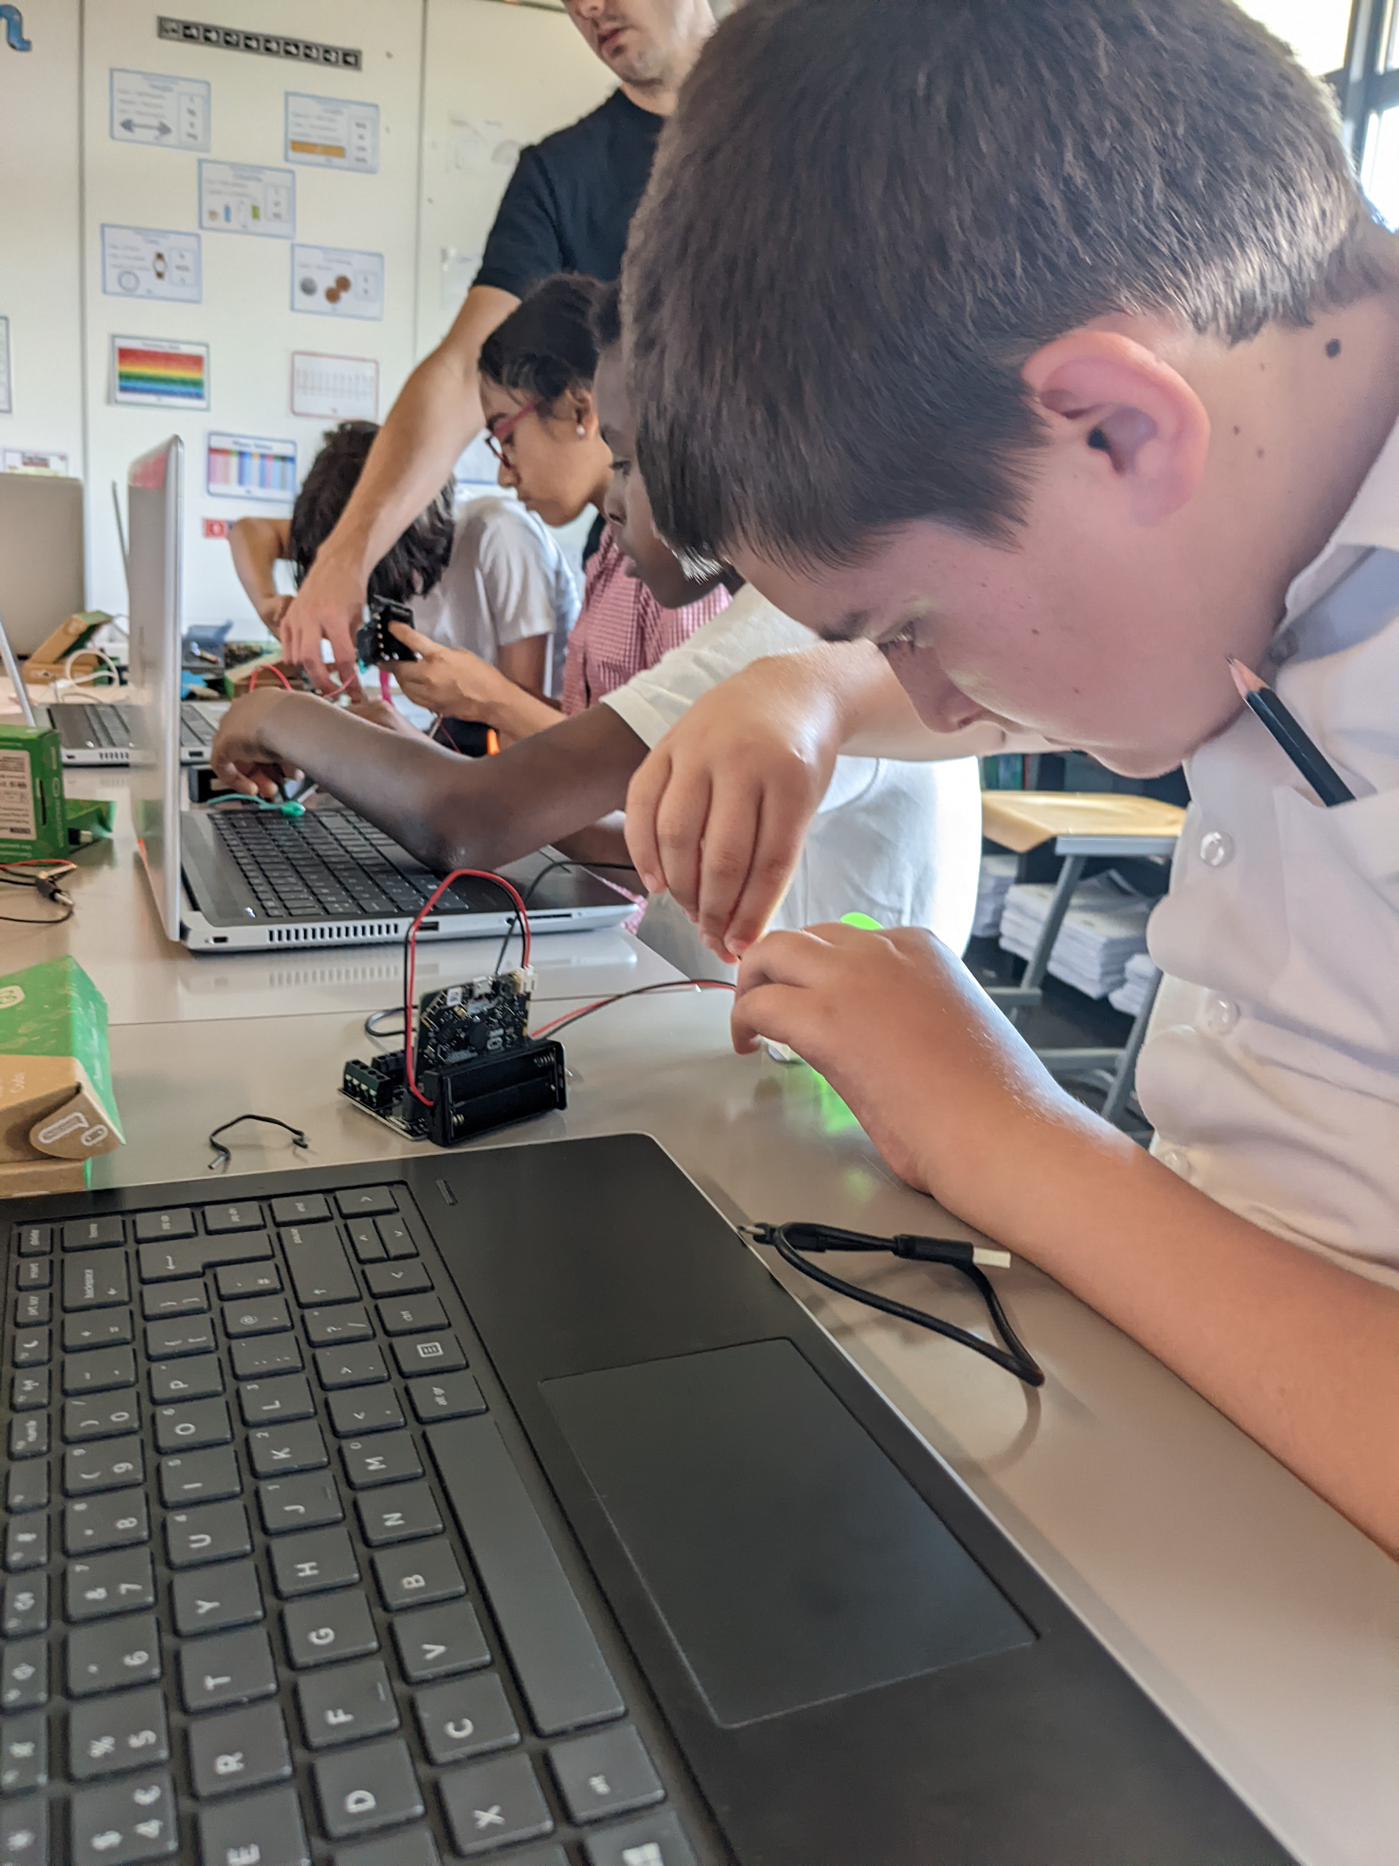
“Using creativity and imagination, pupils design and make products that solve real and relevant problems within a variety of contexts, considering their own and others’ needs, wants and values.
They acquire a broad range of subject knowledge and draw on disciplines such as mathematics, science, engineering, computing and art. Pupils learn how to take risks, becoming resourceful, innovative, enterprising and capable citizens. Through the evaluation of past and present design and technology, they develop a critical understanding of its impact on daily life and the wider world.”
Because design and innovation matter
Notes:
14,800 trained specialists in 2009, less than 6,500 now. This NC statement of intent is as valuable and relevant as it ever was

Slide 18

AT KS3 THE REALITY IS…
In too many schools the curriculum offer is dictated by:
Timetable carousels dictating six-week blocks (food, textiles, resistant materials). Compliance to set blocks of time serves to re-enforce barriers to learning, compartmentalises the subject to false sectors and stifles innovation.
Teacher expertise is forcing teachers to “teach where they are comfortable”.
A fixation on the end-product rather than the content and process which really matter.
Insufficient time and resource is spent on teaching cutting-edge relevant content that helps to solve global and local issues.
Because design and innovation matter
Notes:
Move to systems and design thinking and focus on the process not just the outcome

Slide 19


We are working to add context to KS3 learning by working with business and industry to take real problems they are currently facing and packaging these with suitable resources (including video content) that students can use to develop their knowledge, skills and understanding of the importance of the subject.
Sustainability, net-zero and the need for a circular economy to be given prominence in teacher training and study.
Students to concentrate on identifying problems, researching and experimenting, iterating and testing potential solutions before designing a prototype solution to a problem. ‘Human skills’ to be developed alongside subject knowledge and skills.’
PROPOSED KS3 Development
“In an age where AI will have an ever increasing influence in the workplace; once labelled ‘soft skills’ will become more important than ever as they cannot be easily replicated by machines.”
Pamela Kearney – EU HR Director, Amazon
Because design and innovation matter
Notes:
Real-world problems allow students to see the relevance and value of the subject. Bringing industry and education closer together with a common cause.

Slide 20

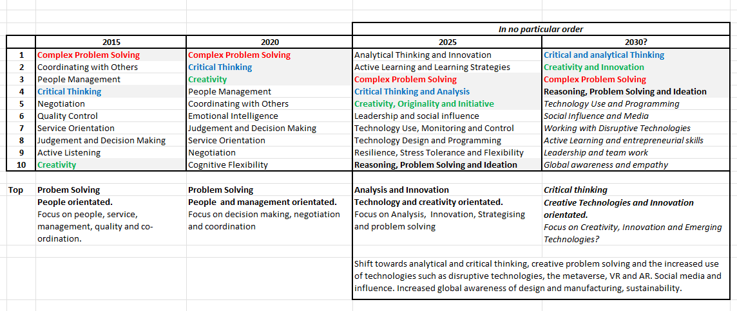
What do we mean by 'human’ skills?
World Economic Forum
Because design and innovation matter
Notes:
OK so the Government are aware of this but is happy to ignore it to focus on ‘the power of knowledge and PISA rankings. Can we afford to ignore this any longer?

Slide 21
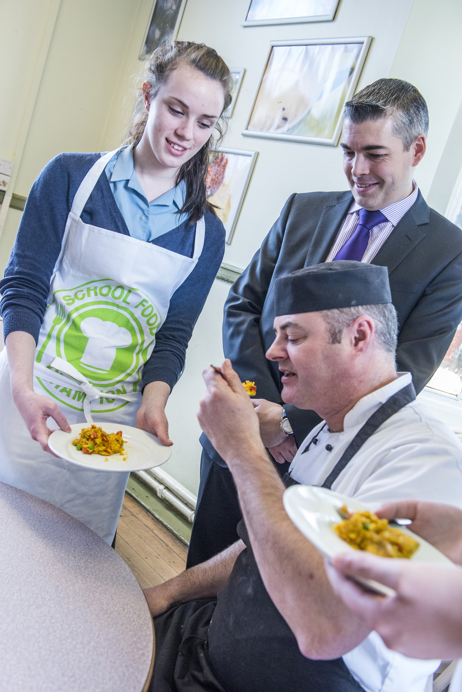


FOOD AND NUTRITION STUDIES
This currently sits within D&T studies at Key stages 1,2 and 3 (Ages 5-14). I am led to believe the DfE is minded to remove this from the design and technology curriculum and place this as a core aspect of study for all students (akin to PSHCE).
This makes some sense if it means all young people in England will receive basic food preparation and nutritional education, but at the same time, we need to ensure that this important educational curriculum area is not marginalised.
This aspect of the curriculum needs to be openly and professionally discussed.
Because design and innovation matter
Notes:
We intend to hold a series of webinars to consult with Food and Nutrition teachers. I personally think its time within D&T is limited.

Slide 22


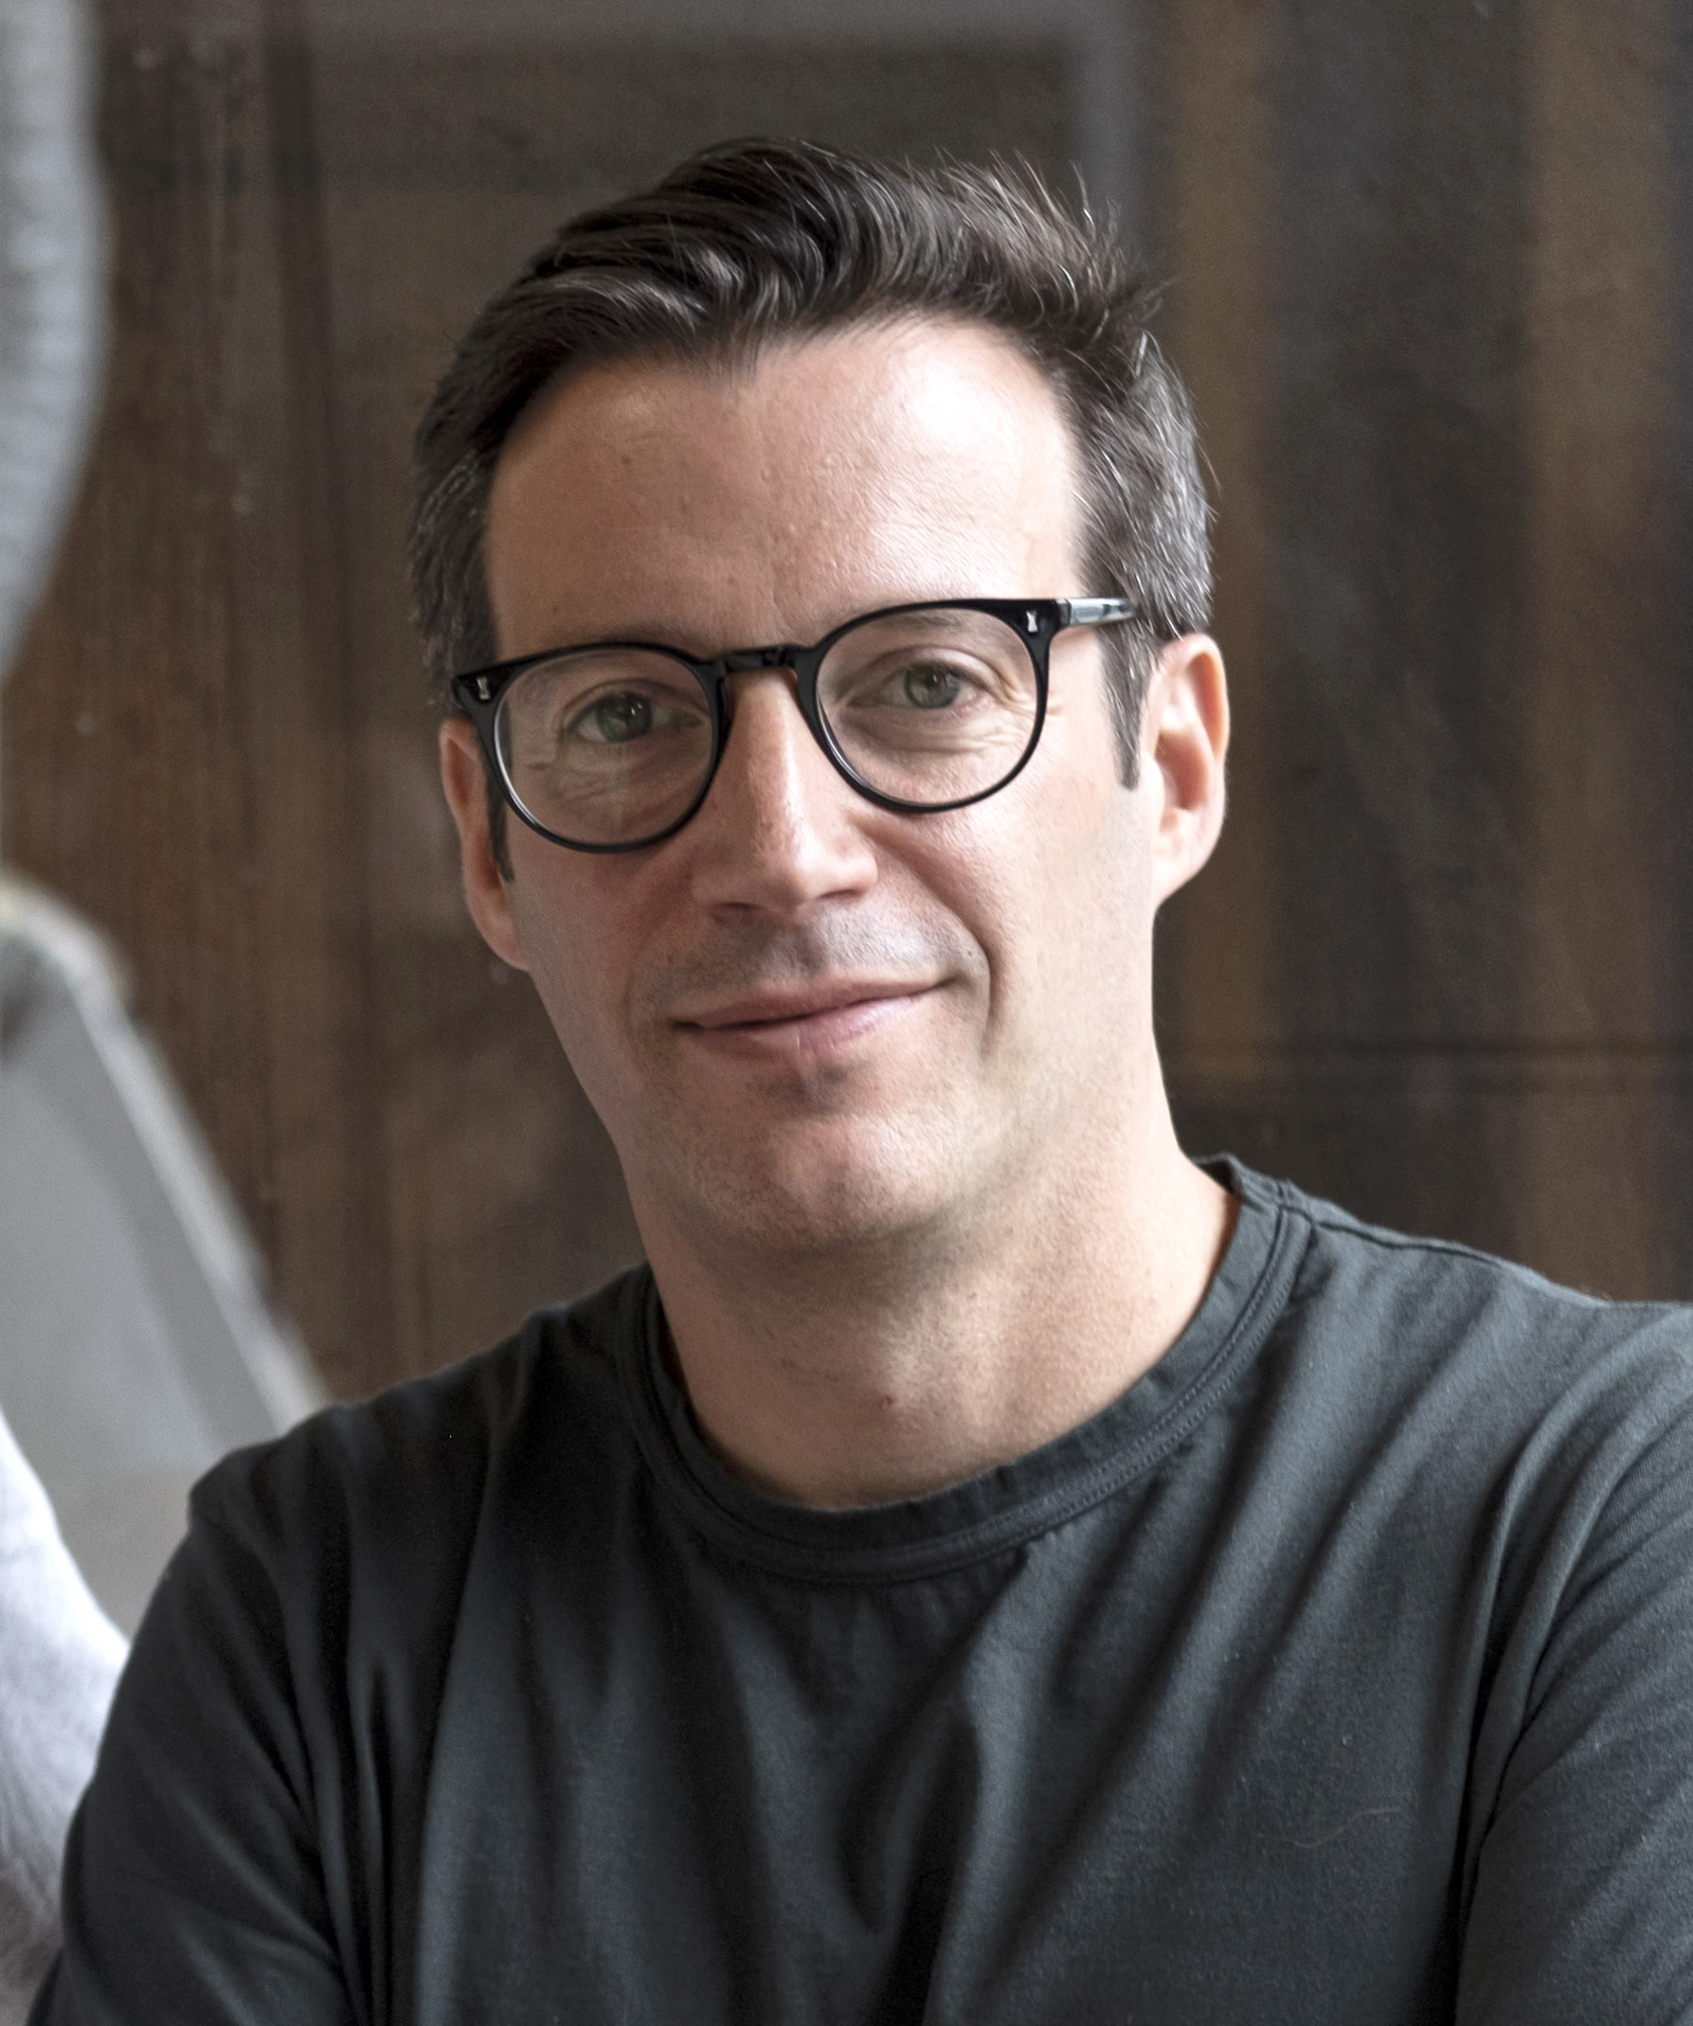

KS4 THOUGHTS
AND PROPOSALS
Because design and innovation matter
Richard Joseph – Co-Founder and Creative Director Joseph Joseph

Slide 23

KS4 – CURRENT ISSUES
There is too much content in the KS4 syllabi (more than there is in the A Level)! Through a period of consultation, we need to slim this content down.
Depending on the examination award selected, realising outcomes can carry a very small percentage of marks on the NEA. Design, engineering and manufacturing are not and cannot be theoretical. Our subject must engage head, hand and heart.
The heavy content load is forcing teachers to look for ‘easier’ and less burdensome qualifications. 3D Art & Design, because of its lack of core material content and 100% coursework (no exam) assessment, is drawing even the most capable schools away from D&T.
Textiles teachers are, in the main, not comfortable with the core content and have moved on mass to art & design. In my opinion, textiles should be a material studied in D&T.
Because design and innovation matter
Notes:
Increase the percentage of marks for realisation of the idea (prototyping) or make allocation more explicit. Slim down core content. (Art & Craft, not Art & Design)! Is it too late for textiles?

Slide 24


The Non-examined assessment (NEA) 50%
We propose that the NEA remains pretty much as it currently stands. Teachers now understand how to effectively manage this (a problem when it was first launched as, by definition, it requires all students to work on unique solutions). Students also understand this task, and their response to the demands of this aspect of work is improving.
Some contexts are becoming a little obtuse to encourage true inclusivity.
Because design and innovation matter
Notes:
Contexts to be set across boards by a panel of industry leaders, AOs, and The Association. 12/15 each year. Boards welcome this suggestion; they are struggling

Slide 25


CORE CONTENT WRITTEN EXAMINATION (25%)
A one-hour written examination testing students’ knowledge of a ‘slimmed down’ core curriculum.
Because design and innovation matter
Notes:
Checking what students ‘know’ more so than what they understand. Could increasingly be marked by computer/AI and checked by humans. OCR and AQA keen to keep 3-6 mark questions

Slide 26

PRODUCT DESIGN TASK 90Mins (Option 1)
The Awarding Organisations to set a series of design tasks, taken under high-control conditions and marked by the awarding organisation.
This would be a sketching and writing task to :
Evaluate a product to identify design issues/areas for improvement, and
A redesign activity to sketch an improved design idea and provide justification for the changes.
Initial conversations with AOs suggest that this may be more palatable to the DfE and OFQUAL.
Because design and innovation matter
Notes:
Most palatable with Aos and probably with DfE and OFQUAL

Slide 27


Proposed student investigation (25%) Option 2
Awarding organisations to set a series of ‘set contexts for investigation’ each year on a set date. Students are given a choice of which context they chose to investigate (handing some control back) and allowing young people to ‘deep-dive’ into a field of particular interest to them, for example:
‘an investigation into the practicalities of growing a circular economy when taking into consideration capitalist demands for fast fashion’.
Assessment for this unit could be split between a written submission to a deadline produced under teacher supervision and a video-recorded presentation to an unfamiliar audience on their chosen topic.
Because design and innovation matter
Notes:
Concentrating on deep knowledge acquisition and the ability to present. Students suffering from anxiety to be allowed to present to a known teacher (non-D&T). Time demands accepted. (EPQ model)

Slide 28


Specialisation (Option 3)
An option allowing students (and teachers) the option to specialise in one of three designated areas of study, these being:
Textiles
Product Design
Engineering
Through the examination (format to be determined) students will be able to demonstrate deep knowledge and understanding of their chosen specialist area of study.
Assessment to cover knowledge of the specialist area but to also reach into areas of understanding of how this knowledge can be applied to a context.
Because design and innovation matter
Notes:
Most palatable with Aos and probably with DfE and OFQUAL. Whatever format is chosen for GCSE will be mirrored at A Level

Slide 29

You are seeing this before public release.
This is very much a ‘work in progress’ as we seek to save our subject. Our priorities this year as an Association are to:
Build our Blueprint 1000 membership to 40+, bringing education and industry closer together.
Further digitise our professional development and our ‘offer’ to members.
Lobbying and leading subject change.
I welcome feedback, both positive and developmental.
Thoughts and observations
Because design and innovation matter
Notes:
We are working to be the “one stop shop” for everything D&T

Slide 30
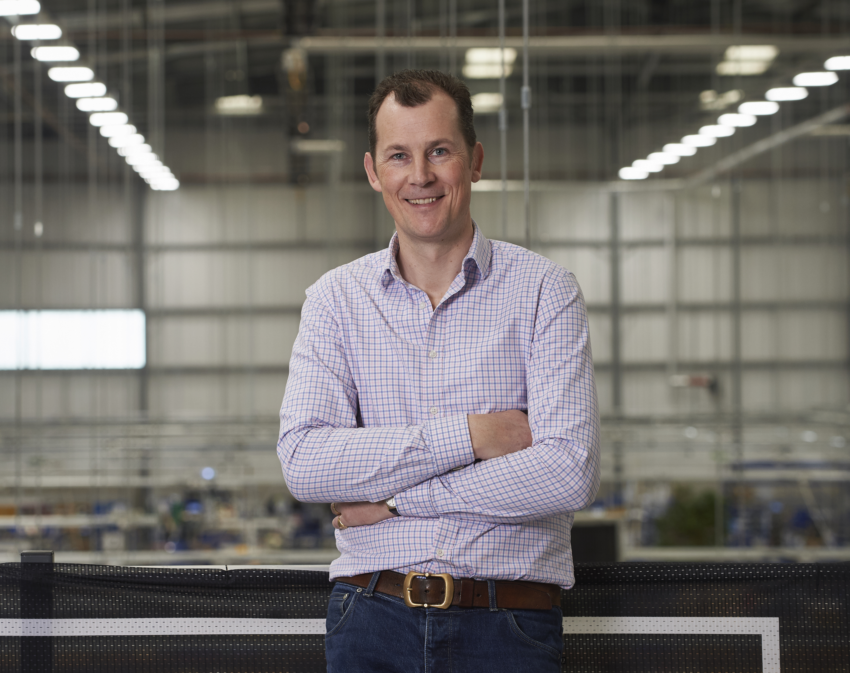
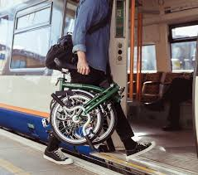
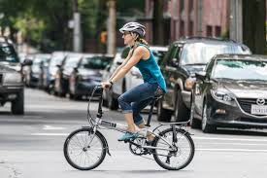


“The very future of the world that we live in lies in the hands of our young people. The solutions are there; we just need to encourage them of the importance of creativity, problem-solving and believing in their own potential”
Will Butler-Adams
Chief Executive Brompton Bicycles
Notes:
Bringing Will into my school. Why and what students gained from this

Slide 31


Tony Ryan CEO
Tony.Ryan@designtechnology.org.uk
@DesTechRyan
www.designtechnology.org.uk

